Slide 1

Page Setup
Set up the first page of every lesson like this and rule a column line for every page after the first page that is used during the lesson.
Focus: State the Chapter Number, Title and the page numbers (3 lines).
Keywords: During the lesson write out your own keywords used during the lesson. (8 lines)
Context: During the lesson write in this section what this topic relates to in the ‘real’ world. How is this content used to better society? (5 lines)

Slide 2
Radiation
Chapter 3.1
Pages 74 - 76

Slide 3
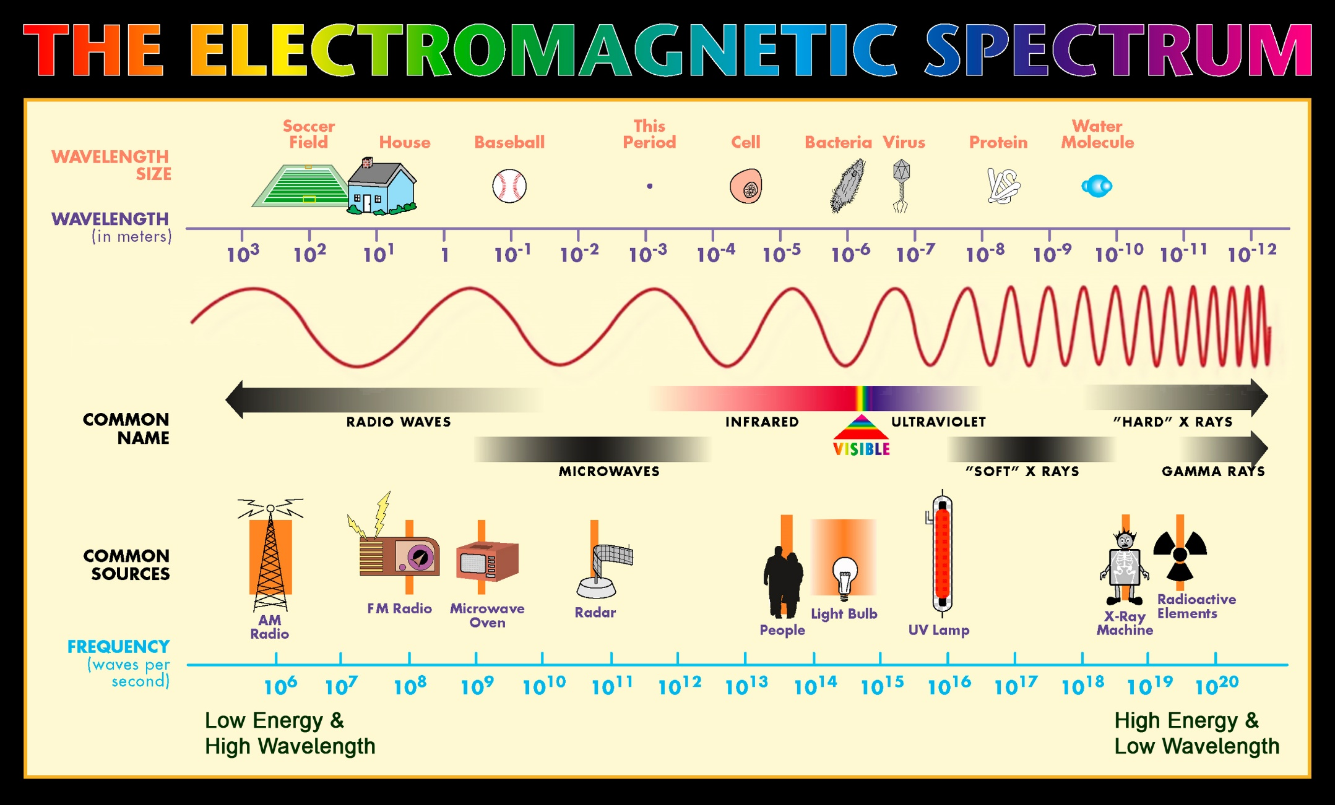

Slide 4
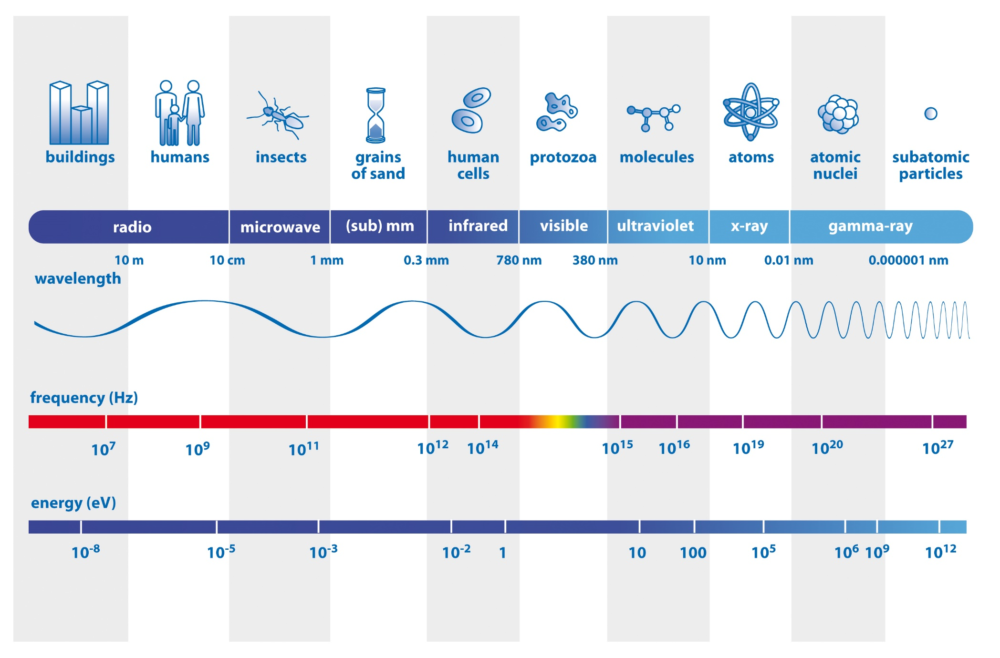
Electromagnetic Spectrum

Slide 5
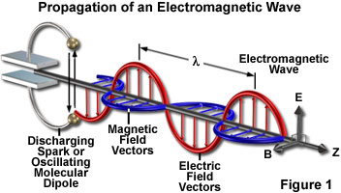
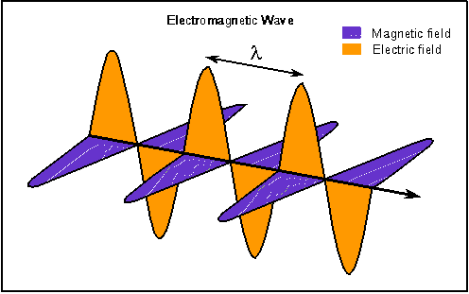
Family of Electromagnetic Radiation
Electro..... Magnetic!
c = f λ, where c is constant.

Slide 6
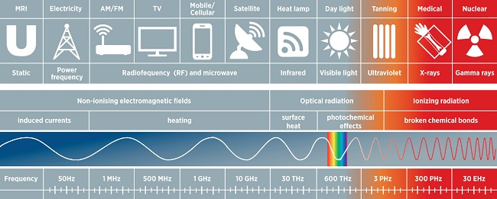
Ionising & Non-ionising radiation
To ionise is to change the electron configuration of an atom by removing/adding electrons to an atom to create a charge.
Removing electrons is achieved by adding enough energy to the electron, that it is capable of escaping the atom.

Slide 7
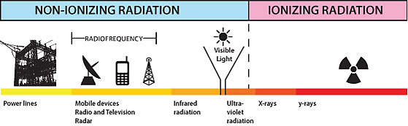
Ionising & Non-ionising radiation
Non-ionising radiation is low energy (low frequency & high wavelength) that can still affect the body (e.g. Infrared excites the atoms to give the feeling of “warming up”). However, this does not change the electron configuration of the atoms themselves.

Slide 8
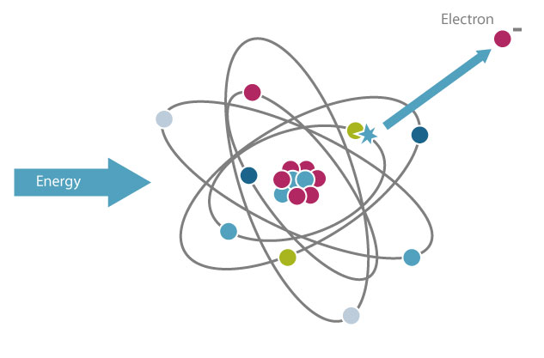
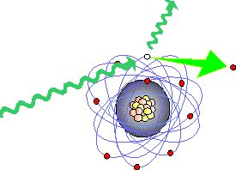
Ionising & Non-ionising radiation
Ionising radiation (high frequency & low wavelength) is high energy radiation that can pass energy onto the electron. If the electron receives enough energy then it is capable of leaving the atoms orbit. Hence the atom becomes ionised.
High UV, X-ray and Gamma wavelengths as well as Alpha and Beta particles are capable of ionising atoms.

Slide 9
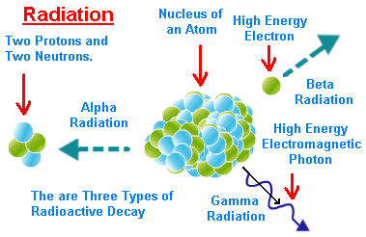
Alpha, Beta and Gamma
Radioactive decay involves the emission of energy from the nucleus. The three forms are Alpha, Beta and Gamma.

Slide 10
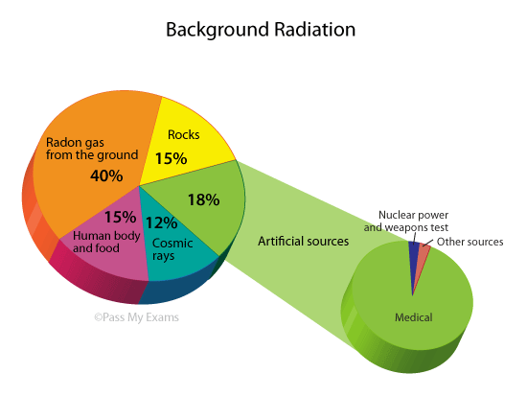
Background Radiation
There are many forms of background radiation.

Slide 11
Background Radiation
Radiation is everywhere
There are many forms of background radiation.
Cosmic
Inhaled Radon
Bodies
Plants
Radioactive Elements
Rocks
We live in a sea of radiation…

Slide 12
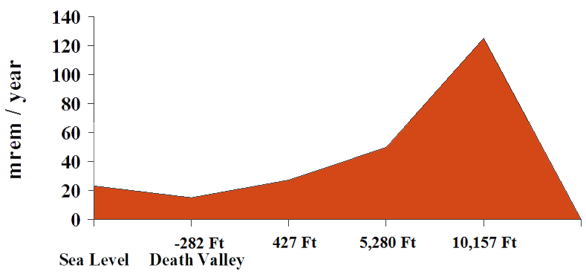
Cosmic rays
Because this type of radiation is somewhat shielded by the atmosphere, the dose is higher at higher altitudes.

Slide 13


Rocks
Some rocks, like Uranium are radioactive. So is coal and some building materials such as Granite.
The natural radiation from the Granite in Grand Central Station is higher than is allowed to certify a nuclear power plant.

Slide 14
Food we eat
Cells in our body contain radioactive elements, such as Potassium, which come from the food we eat.
Milk

Slide 15
Food we eat
Potassium, Lead and Carbon are the common types of radiation found in our bodies through consumption of food.

Slide 16


Radon Gas
.
Usually radon escapes into the air in very small amounts and does not hurt us. However, sometimes radon can get trapped in buildings. Then there is more radiation than is healthy for us.

Slide 17
Radon Gas
Radon is a radioactive, colourless, odourless, noble gas, occurring naturally as one intermediate step in the decay chains, through which Thorium and Uranium slowly decay into Lead. Thorium and Uranium are the two most common radioactive elements on earth.
Radon is found in Uranium ores; Phosphate rock; Shales; Igneous and Metamorphic rocks such as Granite, Gneiss, and Schist; and, to a lesser degree, in common rocks such as Limestone.
On a global scale, it is estimated that 2,400 million curies of radon are released from soil annually.
(if 1 Ci = 3.7 × 10¹⁰ decays per second).
This equate to 2.8 x 10²⁷ decays annually.

Slide 18
For anyone interested
Sand is made up of Silica this has the formula SiO₂ Silicon weighs 28 atomic units Oxygen weighs 16 atomic units so each SiO₂ weighs 60 atomic units
There are 6.023 x 10²³ atomic units in a gram of SiO₂.
So there would be 6.023 x 10²³ / 60 = 1x 10²² SiO₂ molecules in a gram of sand, so there is 3 x 10²² atoms in a gram of sand.
Say a grain of sand is 1mm across it has a volume of 0.001cm³ 1cm³ of sand weighs about 2.6g, so a grain of sand will weigh 0.0026g (estimations).
So to find the number of atoms in a grain of sand we multiply the number of atoms per gram by the number of grams: 3 x 10²² x 0.0026g = 7.8 x 10¹⁹ atoms in a grain of sand
So if there are 2.8 x 10²⁷ decays annually, this equates to 3.592 x 10⁷ pieces of sand. If each piece weighs 0.0026g, then the amount of
Radon produced each year is equivalent to 93.4 tonnes of sand.

Slide 19
Homework, Context & Keywords
Context: How is this content used to better society?
Key words:
Considering the relevance to background radiation on Earth and in Space and what it means in the health of Humans.
Ionising Radiation
Background Radiation
Radioactive
Decay
Alpha
Beta
Gamma

Slide 20
Homework, Context & Keywords
Homework:
Complete all questions from
Nelson Set 3.1
due first lesson next week.
Read Chapter 3.2 & 3.3 page 76-85 and answer
Q1&2 Set 3.2 and
Q1&2 Set 3.3
by next lesson.

Slide 21
Page Setup
Set up the first page of every lesson like this and rule a column line for every page after the first page that is used during the lesson.
Focus: State the Chapter Number, Title and the page numbers (3 lines).
Keywords: During the lesson write out your own keywords used during the lesson. (8 lines)
Context: During the lesson write in this section what this topic relates to in the ‘real’ world. How is this content used to better society? (5 lines)

Slide 22
Atoms, Isotopes, Radiation and Radioisotopes
Chapter 3.2 & 3.3
Pages 76-81 & 81-85

Slide 23
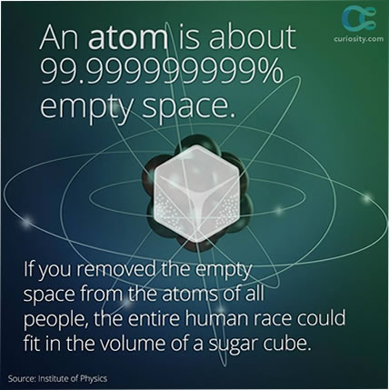
Atoms
Nucleus
Account for nearly all the mass of an atom.
Make up only 10⁻¹² of an atoms volume.
Protons – positively charged.
Neutrons – no charge
(electrically neutral).
Electrons
Accounts for most of the
volume of an atom.
Orbits the nucleus at high
speed.
Negatively charged.

Slide 24
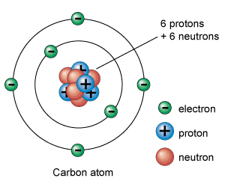
Atoms
An atom is mostly empty space.
Protons and neutrons have approximately the same mass.
Protons and electrons have approximately equal, but opposite charge.
Ions are where an atom
gains or loses an (or
many) electrons.

Slide 25
Protons, Neutrons and Electrons
Particle | Symbol | Charge (C) | Mass (kg) | Mass (μ)
Proton |  | +1.60 × 10⁻¹⁹ | 1.673 × 10⁻²⁷ | 1.0073
Neutron |  | 0 | 1.675 × 10⁻²⁷ | 1.0080
Electron |  | –1.60 × 10⁻¹⁹ | 9.11 × 10⁻³¹ | 0.00055
NOTE: μ is “atomic mass unit”
When working out the mass of an atom, include the electron, but if relating to mass defect, then exclude all electrons.
Example 3.2a:
What is the mass of the following (in kg and μ)
i) ¹₁ H⁺
Has 1 proton, 0 neutrons, and 0 electrons
Mass = 1.673 × 10⁻²⁷ kg
Mass = 1.0073 μ

Slide 26
Protons, Neutrons and Electrons
Example 3.2a continued:
ii) Calculate the mass of the nucleus for ¹ ₈ ⁶ O⁻²
Has 8 proton, and 8 neutrons
Mass = 8 × 1.673 × 10⁻²⁷ + 8 × 1.675 × 10⁻²⁷
= 2.68 × 10⁻²⁶ kg
Mass = 8 × 1.0073 + 8 × 1.0080
= 16.1224 μ
iii) Calculate the mass of the atom for ⁷₃ Li
Has 3 proton, 4 neutrons, and 3 electrons
Mass = 3 × 1.673 × 10⁻²⁷ + 4 × 1.675 × 10⁻²⁷ + 3 × 9.11 × 10⁻³¹
= 1.17 × 10⁻²⁶ kg
Mass = 3 × 1.0073 + 4 × 1.0080 + 3 × 0.00055
= 7.0556 μ

Slide 27
Symbol of Elements
^{A} _{Z} X
Where
Z (atomic number) – number of protons if the proton number changes, then so does the name of the element.
A (mass number) – number of protons and neutrons in an atom.
X (element name) – the element name is defined by the number of protons.
NOTE: Atomic number defines the element.

Slide 28
Isotopes
Where the number of neutrons vary for a given element, but the number of protons are unchanged. Isotopes of an element are chemically similar, making them difficult to separate as they only differ slightly in mass and density.
Example:
a) Hydrogen
Hydrogen-1 ¹ ₁ H
Hydrogen-2 ² ₁ H → deuterium
Hydrogen-3 ³ ₁ H →tritium
b) Chlorine
Chlorine-35 ³₁⁵₇ Cl → has 18 neutrons
Chlorine-37 ³₁⁷₇ Cl → has 20 neutrons

Slide 29
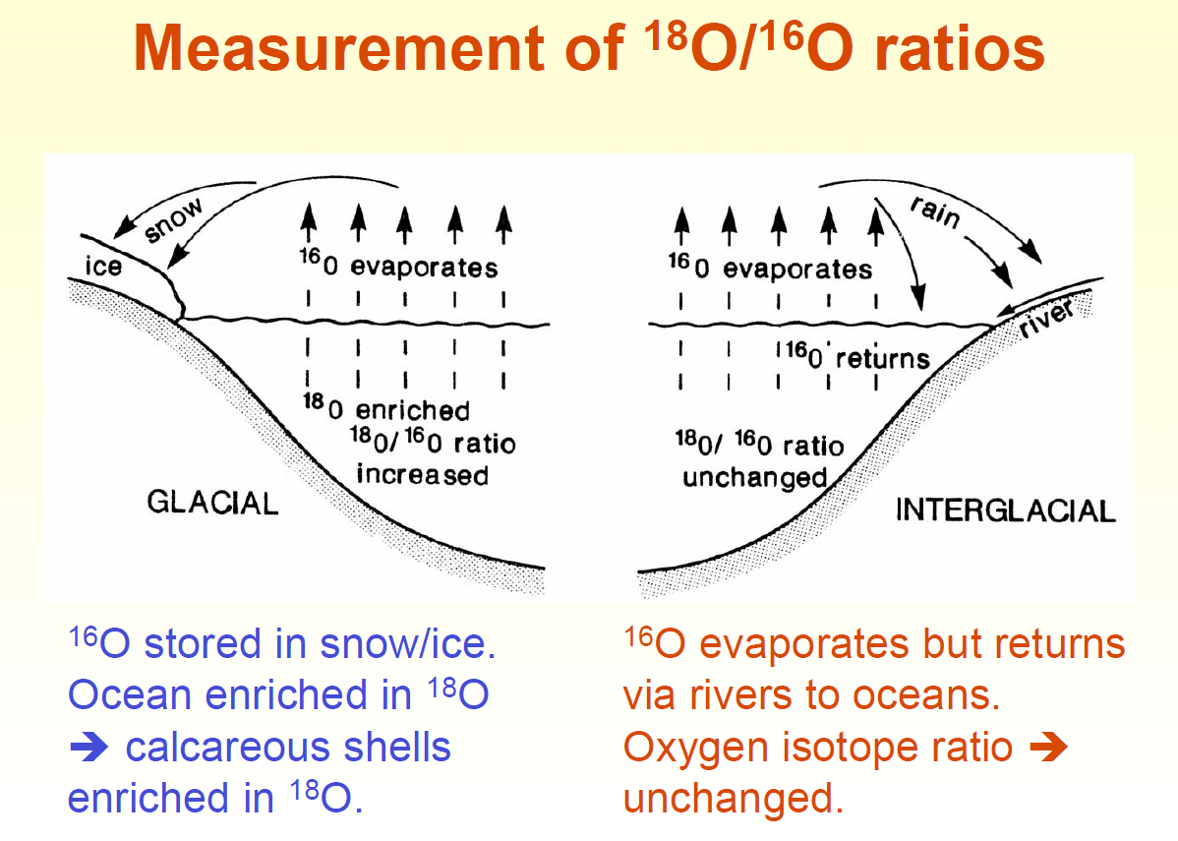
Real Life Uses for Understanding Isotopes

Slide 30
Real Life Uses for Understanding Isotopes
Both oxygen-16 and oxygen-18 are stable. Since oxygen-16 is lighter it evaporates easily. The percentage or ratio of oxygen-16 to oxygen-18 found in fossil shells can determine if a period of time was experiencing glacial or interglacial climate.

Slide 31
Isotopes
There are 270 naturally occurring stable isotopes from the 92 known stable elements.
Some elements have many (e.g. Tin has 10 stable isotopes), where others (e.g. Aluminium) only have one.
All isotopes of the one element react and bond with other elements in precisely the same way (neutrons do not affect/influence an atoms ability to interact).

Slide 32
Radioisotopes
Radioisotopes are isotopes that are unstable and emit nuclear energy during decay, hence are radioactive.
The nucleus usually spontaneously loses energy by emitting a particle.
Emitting a particle can change the
Type of element.
Type of isotope and remain the same element.
The atoms are unstable due to the number of neutrons to protons in the nucleus.
All bonds in the nucleus between protons and neutrons are strong nuclear bonds.
There are over 2000 known radioisotopes, most are artificial.
K-feldspar is a mineral in igneous rock. As it weathers to a clay the Potassium decays to Argon.

Slide 33
Homework, Context & Keywords
Context: How is this content used to better society?
Key words:
Mass of atoms helps predict behaviour so elements can be efficiently used.
Isotopes help determine historical events of our Earth, including climate variations.
Radioisotopes can be used to develop medical research, energy research, dating of rocks, etc
Isotopes
Radioisotopes
Glacial
Inter-glacial
K-Feldspar

Slide 34
Homework, Context & Keywords
Homework:
Complete all questions from
Nelson Set 3.2 & Set 3.3
Chapter 3.2 & 3.3 Extra Questions
Chapter 3.2 & 3.3 Exam Questions
due first lesson next week.
Read Chapter 3.4 page 85-89 and answer
Q1&2 Set 3.4
by next lesson.

Slide 35
Page Setup
Set up the first page of every lesson like this and rule a column line for every page after the first page that is used during the lesson.
Focus: State the Chapter Number, Title and the page numbers (3 lines).
Keywords: During the lesson write out your own keywords used during the lesson. (8 lines)
Context: During the lesson write in this section what this topic relates to in the ‘real’ world. How is this content used to better society? (5 lines)

Slide 36
Alpha, Beta & Gamma Radiation
Chapter 3.4
Pages 85-89

Slide 37
Alpha Radiation
⁴ ₂ α
Heavy nucleus that needs to undergo radioactive decay.
The alpha particle is identical to Helium, but with a +2 charge (no electrons).
The alpha radiation is shot out of the nucleus as a positively charged particle with large mass.
Alpha particles only travel short distances as they are slowed by surrounding matter and their negatively charged electrons.
Alpha particles will steal electrons and become Helium after a short period of time.

Slide 38
Alpha Radiation
Example
²₉³₀⁰ Th → ²₈²₈⁶ Ra + ⁴₂ α + energy
Example 3.4a:
Find the daughter nucleus for the following if they alpha decay
a) ²₉³₂⁸ U → ______ X + ⁴₂ α + energy
→ ²₉³₀⁴ Th + ⁴₂ α + energy
b) ²₉³₀² Th → ______ X + ⁴₂ α + energy
→ ²₈²₈⁸ Ra + ⁴₂ α + energy
c) ²₈¹₄⁶ Po → ______ X + ⁴₂ α + energy
→ ²₈¹₂² Pb + ⁴₂ α + energy

Slide 39
Beta Radiation
⁰ ₋₁ β
Where an electron is emitted from the nucleus (not the electron cloud).
This is a single negative charge that has a mass number of zero.
The imbalance of protons and neutrons result in a neutron changing to a proton and an electron. This is known as beta negative decay.
Beta positive decay is less common and is where the nucleus has too many protons. The proton decays by addition and particles are expelled.

Slide 40
Beta Radiation
Beta negative decay.
¹₀ n → ¹₁ p + ⁰₋₁ e + v_ + energy
where v_ is an antineutrino of no charge and virtually no mass.
Example: β⁻ decay
³₁ H → ³₂ He + ⁰₋₁ e + v_ + energy
Beta positive decay.
¹₁ p → ¹₀ n + ⁰₁ e⁺ + v + energy
where v is an neutrino of no charge and virtually no mass.
e⁺ is a positron of equal values to an electron, except opposite charge.
Example: β⁺ decay
¹₉⁸ F → ¹₈⁸ O + ⁰₁ e⁺ + v + energy

Slide 41
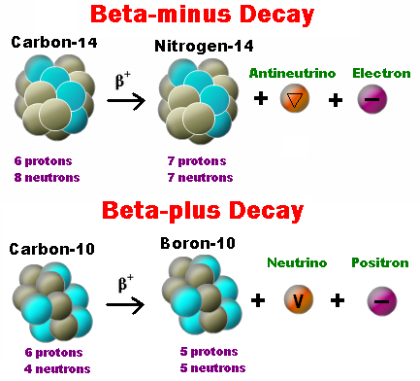
Beta Radiation
Beta radiation travels further than alpha radiation because the charge of the Beta particle (being negative) is less likely to find a willing atom to take it in. Instead it is repelled by the electron shell of the surrounding atoms.

Slide 42
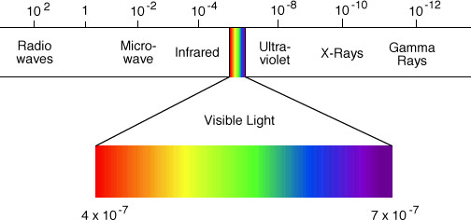
Gamma Radiation
⁰ ₀ γ
Is the excess energy the "daughter" nucleus holds after a "parent" radioisotope has emitted an alpha or beta particle.
After the daughter nucleus has rearranged itself it may need to "off-load" this excess energy in the form of gamma rays.
Gamma radiation is part of the electromagnetic radiation spectrum.

Slide 43
Gamma Radiation
Gamma radiation has no mass and no charge, being a form of electromagnetic radiation, hence has no effect on balancing a nuclear equation.
Example Dysprosium to Holmium
¹₆⁶₆⁶ Dy → ¹₆⁶₇⁶ Ho + ⁰₋₁ β + v_ + ⁰ ₀ γ

Slide 44
Terminology
Transmutation – when an element changes into another element under radioactive decay where the "parent" nucleus becomes a completely different "daughter" nucleus.
Artificial Transmutation – when the element is forced to undergo transmutation, where under normal circumstances, this would not occur.

Slide 45
Artificial Transmutation
200 naturally occurring and 2000 artificial radioisotopes
Methods of producing artificial radioisotopes.
Neutron absorption: stable isotopes are irradiated (bombarded) with neutrons in a nuclear reactor.
Particle accelerator: charged particles are impacted with the nucleus at high speeds. The Hadron Collider uses ionised hydrogen (H⁺) to bombard past the electron cloud and into the nucleus of an element of larger atomic mass.

Slide 46
Radioactive nuclei
In a stable nuclei the protons are neatly balanced between neutral neutrons, but more significantly there is a "strong attractive" force that exists at the sub atomic level which counteracts the strong repulsive force that exists between the protons.
The "strong attractive" force exists in the form of energy between all nucleons (I.e. Protons and neutrons), hence even adding a "neutrally charged" neutron to a nucleus can affect the nucleus's ability to distribute the "strong attractive" force and keep all the nucleons in the nucleus.

Slide 47
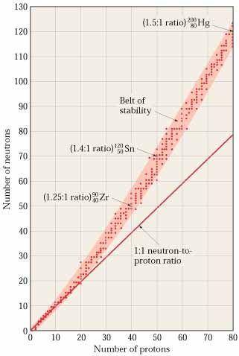
Isotopes
The ratio of neutrons to protons increase as the number of protons increase. The ratio does not stay a nice neat 1:1 ratio.
This is because proton-proton repulsion becomes significant, as the number of protons increases (being surrounded three dimensionally and embedded in the nucleus). Cohesive nuclear forces arise from neutrons, so the neutron to proton ratio must increase for heavier elements.
For mercury Hg- 200 the ratio is 1 : 1.5
For helium He- 4 the N:P ratio is 1 : 1

Slide 48
Homework, Context & Keywords
Context: How is this content used to better society?
Key words:
Formation of new isotopes and radioisotopes to better understand the formation of our Universe.
Developing undefined radioisotopes that are better suited to particular medical research, energy research, dating of rocks, etc
Alpha
Beta
Gamma
Transmutation

Slide 49
Homework, Context & Keywords
Homework:
Complete all questions from
Nelson Set 3.4
Chapter 3.4 Extra Questions
Chapter 3.4 Exam Questions
due first lesson next week.
Read Chapter 3.5 page 90-95 and answer Q1&2 from Set 3.5
by next lesson.

Slide 50
Page Setup
Set up the first page of every lesson like this and rule a column line for every page after the first page that is used during the lesson.
Focus: State the Chapter Number, Title and the page numbers (3 lines).
Keywords: During the lesson write out your own keywords used during the lesson. (8 lines)
Context: During the lesson write in this section what this topic relates to in the ‘real’ world. How is this content used to better society? (5 lines)

Slide 51
Properties of Radiation
Chapter 3.5
Pages 90-95

Slide 52
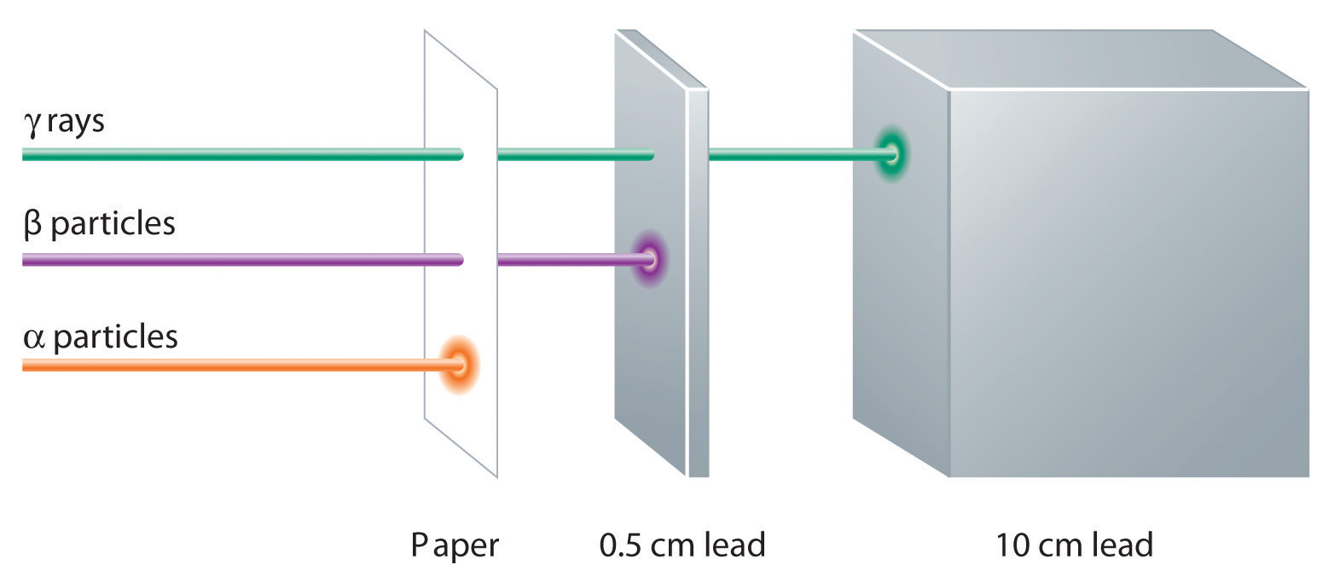
Penetrating Strength

Slide 53
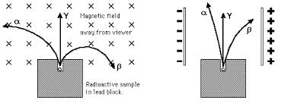
EM Fields on Radiation
Alpha radiation is heavy and due to its mass the particle will follow a large radius when influenced by an electric or magnetic field.
Beta negative radiation, being negative and significantly lighter than an Alpha particle is influenced in the opposite direction to the Alpha particle and the radius is smaller/tighter.
Gamma having virtually no mass and no charge is not influenced at all by the presence of an electric or magnetic field.

Slide 54
Cloud Chamber
Don’t repeat this experiment.
They are not wearing any safety equipment – big No-No!
You can’t just go and buy this stuff – only in America maybe????
Do not play with radiation – become a science teacher if you want to play with the stuff.
Even though I do not condone how they present the making of the cloud chamber, I do appreciate that they explain the reasoning behind the making rather well and better than the dozen of other videos I sifted through. Happy watching!
NOTE: Pb-210 half life 22.2 years Beta emission
Bi-210 half life 5 days Beta emission
Po-210 half life 138 days Alpha emission

Slide 55
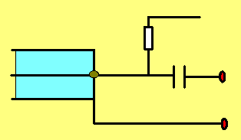
Geiger-Muller tube
The tube is filled with Argon gas at low pressure. About +400 Volts are applied to the thin wire in the middle. When a particle enter the tube, it ionises an Argon atom. The electron produced is attracted to the central wire anode, at high speed and ionises further Argon atoms, causing an "avalanche". Thus one single incoming particle will cause many electrons to arrive at the anode, creating a pulse which can be amplified and counted.
+ve 400V
source
0V
+ve 400V
R
t u b e
C
output
0V

Slide 56
Homework, Context & Keywords
Context: How is this content used to better society?
Key words:
Discovering undefined radioisotopes that are better suited to particular medical research, energy research, dating of rocks, etc
Geiger-Muller

Slide 57
Homework, Context & Keywords
Homework:
Complete all questions from
Nelson Set 3.5
Chapter 3.5 Extra Questions
Chapter 3.5 Exam Questions
due first lesson next week.
Read Chapter 3.6 page 95-99 and answer Q1,2&3 from Set 3.6
by next lesson.

Slide 58
Page Setup
Set up the first page of every lesson like this and rule a column line for every page after the first page that is used during the lesson.
Focus: State the Chapter Number, Title and the page numbers (3 lines).
Keywords: During the lesson write out your own keywords used during the lesson. (8 lines)
Context: During the lesson write in this section what this topic relates to in the ‘real’ world. How is this content used to better society? (5 lines)

Slide 59
Half-life and Activity of Radioisotopes
Chapter 3.6
Pages 95-99

Slide 60
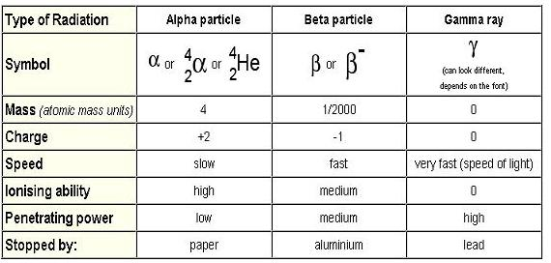
Properties of Radiation

Slide 61
Decay Series
Example 3.6a: Write out the decay series of Uranium-238 given the sequence of decay as;
α, β₂, α₅, β₂, α, β₂, α
Example 3.6b: Write out the decay series of Thorium-232 given the sequence of decay as;
α, β₂, α₄, β → α, β
β, α

Slide 62
Decay Series
Example 3.6a: Write out the decay series of Uranium-238 given the sequence of decay as;
α, β₂, α₅, β₂, α, β₂, α
²₉³₂⁸ U → ⁴₂ α + ²₉³₀⁴ Th → ⁰₋ ₁ β + ²₉³₁⁴ Pa → ⁰₋ ₁ β + ²₉³₂⁴ U → ⁴₂ α + ²₉³₀⁰ Th → ⁴₂ α + ²₈²₈⁶ Ra → ⁴₂ α + ²₈²₆² Rn → ⁴₂ α + ²₈¹₄⁸ Po → ⁴₂ α + ²₈¹₂⁴ Pb → ⁰₋ ₁ β + ²₈¹₃⁴ Bi → ⁰₋ ₁ β + ²₈¹₄⁴ Po → ⁴₂ α + ²₈¹₂⁰ Pb → ⁰₋ ₁ β + ²₈¹₃⁰ Bi → ⁰₋ ₁ β + ²₈¹₄⁰ Po → ⁴₂ α + ²₈⁰₂⁶ Pb

Slide 63
Decay Series
Example 3.6b: Write out the decay series of Thorium-232 given the sequence of decay as;
α, β₂, α₄, β → α, β
β, α
²₉³₀² Th → ⁴₂ α + ²₈²₈⁸ Ra → ⁰₋ ₁ β + ²₈²₉⁸ Ac → ⁰₋ ₁ β + ²₉²₀⁸ Th → ⁴₂ α + ²₈²₈⁴ Ra → ⁴₂ α + ²₈²₆⁰ Rn → ⁴₂ α + ²₈¹₄⁶ Po → ⁴₂ α + ²₈¹₂² Pb → ⁰₋ ₁ β + ²₈¹₃² Bi → ⁴₂ α + ²₈⁰₁⁸ Tl → ⁰₋ ₁ β + ²₈⁰₂⁸ Pb
⁰₋ ₁ β + ²₈¹₄² Po → ⁴₂ α + ²₈⁰₂⁸ Pb

Slide 64
Decay Series
Example 3.6c: Find the decay daughter of Uranium-238 given the sequence of decay as;
α, β₂, α₅, β₂, α, β₂, α
Example 3.6d: Find the decay daughter of Thorium-232 given the sequence of decay as;
α, β₂, α₄, β → α, β
β, α

Slide 65
Decay Series
Example 3.6c: Find the decay daughter of Uranium-238 given the sequence of decay as;
α, β₂, α₅, β₂, α, β₂, α
²₉³₂⁸ U → 8 ⁴₂ α + 6 ⁰₋ ₁ β + _____ X
²₉³₂⁸ U → ³₁²₆ α + ⁰ ₋ ₆ β + ²₈⁰₂⁶ Pb
Example 3.6d: Find the decay daughter of Thorium-232 given the sequence of decay as;
α, β₂, α₄, β → α, β
β, α
²₉³₀² Th → 6 ⁴₂ α + 4 ⁰₋ ₁ β + _____ X
²₉³₀² Th → ²₁⁴₂ α + ⁰ ₋ ₄ β + ²₈⁰₂⁸ Pb

Slide 66
Overview
Alpha radiation has
A large mass.
A +2 positive charge (wants electrons).
Hence
Deflects towards negative charges and away from the positive charges.
Small deflection as an electric field does not influence the ionising properties greatly because of the mass.
Quick to change to Helium.
Is a particle.

Slide 67
Overview
Beta radiation has
A small mass.
A negative charge.
Hence
Deflects greatly towards positive charges and away from the negative charges.
Large deflection as an electric field influences the ionising properties greatly because of the mass.
Difficulty integrating with atoms.
Is a particle.

Slide 68
Overview
Gamma radiation has
Virtually no mass, hence we say no mass.
No charge.
Hence
Does not deflect towards positive or negative charges.
No deflection as an electric field does not influence the ionising properties because there is no mass.
Is an electromagnetic radiation.

Slide 69
Rate of Decay
Rate of decay theoretically decreases by half
A = A_{o} (½)^{n} where A - number of nuclei remaining A_{o} - original number of nuclei N - number of half-life's
Example 3.6e:
What is the original number of nuclei of Pb-212 of a sample, now containing 600 000 nuclei of Pb-212, that has undergone 6 half-lifes.
Solution:
A = A_{o} (½)^{n} 600000 = A_{o} (½)⁶
A_{o} = (600000)/ (½)⁶
A_{o} = 3.84 × 10⁷ nuclei

Slide 70
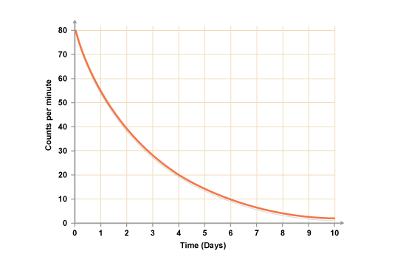
Characteristic Decay Curve
0 T_{½} - 100% (1) undecayed nuclei
1 T_{½} - 50% (0.5 or ½) undecayed nuclei
2 T_{½} - 25% (0.25 or 1/4) undecayed nuclei
3 T_{½} - 12.5% (0.125 or 1/8) undecayed nuclei
4 T_{½} - 6.25% (0.625 or 1/16) undecayed nuclei

Slide 71
Characteristic Decay Curve
So for Sodium-24, which has a half-life of 15 hours. If we take 200 000 atoms of Sodium-24, then theoretically after;
15 hours there is 100 000 atoms of Sodium-24
30 hours there is 50 000 atoms of Sodium-24
45 hours there is 25 000 atoms of Sodium-24
β⁻ decay
²₁⁴₁ Na → ²₁⁴₂ Mg + ⁰₋₁ β + v_ + ⁰₀ γ
NOTE: for an individual atom it is impossible to predict if or when it will decay. So for an individual Sodium-24 atom, within the first 15 hours it may or may not decay (50% chance). So the sample size needs to be large in order to be more accurate.
Rate of decay and type of radiation emitted vary with each element.

Slide 72
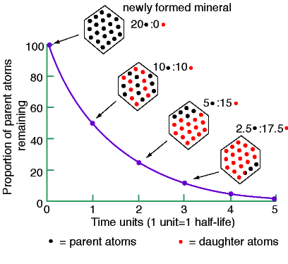
Characteristic Decay Curve

Slide 73
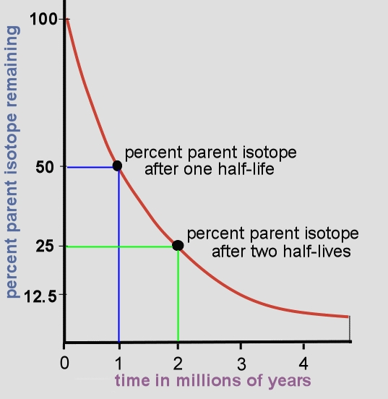
Just remember that at the end of one half-life, 50% of the element will remain. Find 50% on the vertical axis, Follow the
blue line over to the red curve and drop straight down to find the answer:
The half-life of this element is 1 million years.

Slide 74
Find 2 million years on the bottom, horizontal axis. Then follow the green line up to the
red curve. Go to the left and find the answer.
After 2 million years 25% of the original material will remain.

Slide 75
Rate of Decay
Example 3.6f: The radioactive isotope gold-198 is a β⁻ emitter and is often used as a radioisotopic tracer. It can be used by health engineers to trace the flow of sewage. It is found that it's activity drops 1/8 of its original value in just over 8 days.
a) Write the β⁻ decay equation for Gold-198
b) Calculate its approximate half-life.
c) Estimate the fraction of Gold-198 remaining after 2 weeks.
d) Why do you think Gold-198 is used as a tracer?

Slide 76
Rate of Decay
Example 3.6f: Solutions
a) Write the β⁻ decay equation for Gold-198
¹₇⁹₉⁸ Au → ⁰₋ ₁ β + ¹₈⁹₀⁸ Hg
b) Calculate its approximate half-life.
1 → ½ → ¼ → ⅛
1 hɭ 2 hɭ 3 hɭ
Hence it takes 3 half-lifes to drop to ⅛ its activity.
Half-life of gold is 8 days ÷ 3 half-lifes = 2.7 days per hɭ

Slide 77
Rate of Decay
Example 3.6f: Solutions
c) Estimate the fraction of Gold-198 remaining after 2 weeks.
Half-life occurs every 2.7 days and 14 days in 2 weeks
No of half-lifes = 14 ÷ 2.7 = 5.2 half-lifes = 6 half-lifes
1 → ½ → ¼ → ⅛ → ¹⁄₁₆ → ¹⁄₃₂ → ¹⁄₆₄
2.7 d 5.3 d 8 d 10.7 d 13.3 d 16 d
Hence the fraction remaining is ¹⁄₆₄ or (½)⁶
d) Why do you think Gold-198 is used as a tracer?
β decay is easier to trace than α decay (ionisation)
short half-life means it doesn’t remain in the system too long and cause potential harm.

Slide 78
Activity of Radiation
The activity (Bq) of a radioactive sample is defined as the number of nuclei which decay each second. Activity 1 Bq = 1 decay per second.
Bq – Becquerel
Example 3.6g: A 10 mg sample of Strontium-90 is found to have an activity of 24 Bq. It's half-life is 28.5 years. Calculate;
a) The portion of undecayed atoms of Sr-90 remaining after 114 years as a percentage. b) The activity of the sample after this time.

Slide 79
Activity of Radiation
The activity of a radioactive sample is defined as the number of nuclei which decay each second. Activity 1 Bq = 1 decay per second.
Example 3.6g: Solution
a) The fraction of undecayed atoms of Sr-90 remaining after 114 years as a percentage.
half-life = 114 ÷ 28.5 = 4 half-lifes
undecayed nuclei = (½)⁴ x 100 = 6.25 %
100% → 50% → 25% → 12.5% → 6.25%
28.5 y 57 y 85.5 y 114 y
Hence 6.25 % remains

Slide 80
Activity of Radiation
The activity of a radioactive sample is defined as the number of nuclei which decay each second. Activity 1 Bq = 1 decay per second.
Example 3.6g: Solution
b) The activity of the sample after this time.
A = A_{o} (½)^{n} = 24 (½)⁴ = 1.5 Bq
24 Bq → 12 Bq → 6 Bq → 3 Bq → 1.5 Bq
28.5 y 57 y 85.5 y 114 y
Hence 1.5 Bq activity remains

Slide 81
Activity of Radiation
Example 3.6h: Decaying Iodine-131 has a half-life of 8 days. If the sample shows to have a ratio 1:3 of I-131 to Xe-131 after time t, when the original sample was all I-131 at t = 0. Approximately how many half-life's have passed and also how many days.
Example 3.6i: Carbon-14 has a half-life of 5730 years. If a sample taken from an ancient archaeological burnt artefact is estimated to have 6 × 10⁸ nuclei at the time of the burning, how old would the artefact be if the nuclei count is estimated at 3 × 10⁶ nuclei at present.
Example 3.6j:
200 000 Polonium-218 nuclei are collected. The decay rate of Po-218 is 3.05 minutes. After 15.25 minutes, how many nuclei remain?

Slide 82
Half-life examples
Isotope Half-Life Decays to
Polonium-215 0.0018 seconds Lead-211
Sodium-24 15 hours Magnesium-24
Gold-198 2.7 days Mercury-198
Iodine-131 8.07 days Xeon-131
Cobalt-60 5.26 years Nickel-60
Strontium-90 28.8 years Yttrium-90
Americium-241 432.6 years Neptunium-237
Radium-226 1600 years Radon-222
Uranium-238 4.5 billion years Thorium-234

Slide 83
Homework, Context & Keywords
Context: How is this content used to better society?
Key words:
Using defined radioisotopes for particular every day tasks like sewage blockage, etc.
Using defined isotopes for energy emissions.
Half-life
Decay Series
Activity

Slide 84
Homework, Context & Keywords
Homework:
Complete all questions from
Nelson Set 3.6
Chapter 3.6 Extra Questions
Chapter 3.6 Exam Questions
due first lesson next week.
Read Chapter 3.7 page 100-102 and answer Q1 from Set 3.7
by next lesson.

Slide 85
Page Setup
Set up the first page of every lesson like this and rule a column line for every page after the first page that is used during the lesson.
Focus: State the Chapter Number, Title and the page numbers (3 lines).
Keywords: During the lesson write out your own keywords used during the lesson. (8 lines)
Context: During the lesson write in this section what this topic relates to in the ‘real’ world. How is this content used to better society? (5 lines)

Slide 86
Nuclear Medicine.
Chapter 3.7
Pages 100 - 102

Slide 87
Nuclear Medicine
Nuclear medicine is a medical specialty that uses radioactive materials to both diagnose the body and treat disease.
Nuclear medicine procedures may be:
diagnostic studies, which are tests of body function
therapeutic procedures in which the radiation is used to treat disease.
Radionuclide therapy is used in the treatment of both benign disease (eg hyperthyroidism and arthritis) and malignant disease (eg thyroid cancer and hepatocellular carcinoma)

Slide 88
Nuclear Medicine
The radioactive materials administered to patients are known as radiopharmaceuticals.
Medical Physicist - A qualified medical physicist should be responsible for measurement of radionuclide activity, identification of radionuclides and internal radiation dosimetry.

Slide 89
Nuclear Medicine
Exposures From Patient
Contamination External
saliva
perspiration
breath
urine
0.5 0.1 0.06 0.03 mSv/h
1000 MBq
I-131
0 0.5 1 2 m
Part 8. Therapy
89

Slide 90
Nuclear Medicine

Slide 91
Current Methods-Therapy
Radiopharmaceutical For treatment of Route of Maximum administration activity
I-131 iodide Thyrotoxicosis Oral 1 GBq
I-131 iodide Carcinoma of thyroid Oral 20 GBq
I-131 MIBG Malignancy IV 10 GBq
P-32 phosphate Polycythaemia vera IV or oral 200 MBq
Sr-89 chloride Bone metastases IV 150 MBq
Y-90 colloid Arthritic conditions/ Intra-articular 250 MBq
malignant effusions Intra-cavitary 5 GBq
Y-90 spheres Hepatocellular Carcinoma Intra-articular 100 MBq
Er-169 colloid Arthritic conditions Intra-articular 50 MBq
Re-186 colloid Arthritic conditions Intra-articular 150 MBq

Slide 92
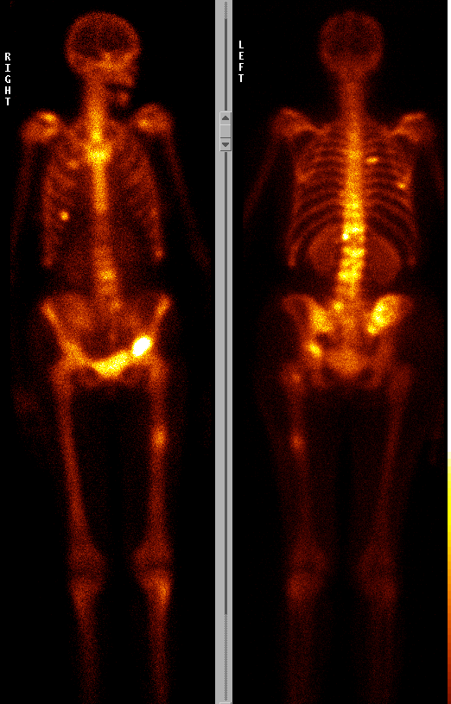
Imaging
Intravenous injection of
a radiopharmaceutical which
includes e.g. Sr-89 or
Sm-153

Slide 93
Homework, Context & Keywords
Context: How is this content used to better society?
Key words:
Using defined radioisotopes for particular every day tasks like cancer treatment, etc.
Half-life
Decay Series
Activity

Slide 94
Homework, Context & Keywords
Homework:
Complete all questions from
Set 3.7
due first lesson next week.
Read Chapter 4.5 page 131-134 and answer Q1,2&3 from Set 4.5
by next lesson.
Chapter 3 Review questions page 105 – 106 due first lesson next week.

Slide 95
Page Setup
Set up the first page of every lesson like this and rule a column line for every page after the first page that is used during the lesson.
Focus: State the Chapter Number, Title and the page numbers (3 lines).
Keywords: During the lesson write out your own keywords used during the lesson. (8 lines)
Context: During the lesson write in this section what this topic relates to in the ‘real’ world. How is this content used to better society? (5 lines)

Slide 96
Absorbed Dose & Dose Equivalent.
Chapter 4.5
Pages 131 - 134

Slide 97
...trying to understand the terminology and units can be confusing, for example
Amount of potassium-40 in the body
Dose to Atomic bomb survivors
You can safety hold this amount of alpha radiation
One coast to coast flight
A diagnostic X-ray
About 2.5 x 10⁻¹² curies
0 - 5 Gray
Billions of Becquerel's
2 x 10⁻³ rads
2 x 10⁻³ - 10 rem
... confusing isn’t it?)

Slide 98
Commonly Used Radiation Units
Each of these units has a different technical meaning. All are used by experts to talk about radiation. With so many terms, you can see why it is important to know what the unit means when you are evaluating radiation information.
Absorbed dose (Gray or rad)
Average dose
Organ dose
Dose commitment
Collective dose
Effective dose (Sievert or rem)
Committed effective dose
Equivalent dose
Collective equivalent dose
Committed equivalent dose
Uniform equivalent dose
Dose equivalent
Collective dose equivalent
Ambient dose equivalent
Directional dose equivalent
Individual dose equivalent
Individual dose equivalent, penetrating
Individual dose equivalent, superficial
Dose and dose-rate effectiveness factor
Man-gray
Man-sievert
Tissue weighting factor
Relative biological effectiveness (RBE)
Quality factor (Q)
Fatality probability coefficient
Nominal fatality probability coefficient
Radiation weighting factor (w_{R})
Linear energy transfer (LET)
Radioactivity (Becquerel or curie)
RAD
REM
Gray
Curie
Sievert
Becquerel

Slide 99
Commonly Used Radiation Units
1 decay per sec = 1 Becquerel (Bq)
37 x10⁹ Bq = 1 curie
1 joule per kg = 1 Gray(Gy)
1 Gray = 100 rad
1 Gray x quality factors = Sievert (Sv)
1 Sievert = 100 rem
RAD
REM
Gray
Curie
Sievert
Becquerel

Slide 100
Absorbed Dose
The absorbed dose is a measure of energy (Joules) per unit mass (kg) in ANY medium (solid, liquid, gas) by ANY type of radiation (α, β or ɣ)
It is a measured physical quantity, but it does not take into account that different types of radiation have different potential effects on the human body.
Absorbed Dose (D) = E .
m
D – absorbed dose (Gray, Gy)
(old units: rad, where 1 Gy = 100 rad)
E – energy (J)
m – mass (kg)

Slide 101
Dose Equivalent
Different types of radiation behave in different ways. In order to compare the amount of risk or biological change that occurs, quality factors are introduced.
For example:
The damage produced by 20 Gy of gamma radiation is equal to that from 1 Gy of alpha radiation. Alpha radiation has a quality factor of 20 compares to that of Gamma which has a quality factor of 1.
Quality factors for other types of radiation are between 1 & 20.

Slide 102
Dose Equivalent
Dose equivalent takes into account the different biological effects or damage to body tissue due to the different types of radiation, even at the same absorbed dose.
Equivalent Dose (H) = D x W
H – equivalent dose (Sievert, Sv)
D – absorbed dose (Gray, Gy)
W – radiation quality factor or radiation weighting factor
Radiation | Weighting Factor W
Gamma/X-ray | 1
Beta particles/Electrons | 1
Protons | 2
Neutrons (all other energies) | 5 - 20
Alpha particles | 20

Slide 103
Dose Equivalent
Once the Dose Equivalent is determined then the following can be expected
Dose Equivalent (Sv) | Body damage
0.25 | Reduction in white blood cell count
1 | Possible nausea, vomiting.
4 | Nausea, diarrhoea, drop in blood cell count.
5 | Loss of hair, 50% die.
10 | Severe damage to central nervous system, death within days

Slide 104
Absorbed Dose
Example 4.5a
James is exposed to 15 J of Alpha radiation, while in another laboratory Jacky is exposed to 3 times the amount (45 J) but of Gamma radiation instead. If James weighs 78 kg and Jacky weighs 72 kg, what would the expected outcomes for both these people be?
Solution
 | James | Jacky
Energy | 15 J | 45 J
Mass | 78 kg | 72 kg
Absorbed Dose | 0.192 Gy | 0.625 Gy
Quality factor W | 20 | 1
Equivalent Dose | 3.85 Sv | 0.625 Sv
Expected Outcome | Nausea, diarrhoea, and a drop in blood cell count. | Reduction in white blood cell count with a very slight possibility of nausea and vomiting.

Slide 105
The effectiveness of the dose is also dependent on the dose-rate.
Dose-rate
Dose
1 bottle of Aspirin
Or
250 rem of radiation
Dose -Rate
Over 50 seconds
Over 50 years
Over 50 seconds
Or over 50 years
Outcome
Death
Minimal health risk
Death
Minimal health risk

Slide 106
Terminology Overview
The activity (Becquerel) of a radioactive sample is defined as the number of nuclei which decay each second. That is 1 activity (Bq) = 1 decay per second.
The absorbed dose is a measure of energy (Joules) per unit mass (kg) in ANY medium (solid, liquid, gas) by ANY type of radiation (α, β or ɣ), measured in Gy.
Dose equivalent takes into account the different biological effects or damage to body tissue due to the different types of radiation, even at the same absorbed dose, measured in Sv.

Slide 107
Homework, Context & Keywords
Context: How is this content used to better society?
Key words:
Determining the amount of radiation a person can handle for radiation therapy and other medical research, etc
Absorbed Dose
Dose Equivalent

Slide 108
Homework, Context & Keywords
Homework:
Complete all questions from
Nelson Set 4.5
Chapter 4.5 Exam Questions
due first lesson next week.
Read Chapter 4.1 & 4.2 page 108-116 and answer Q1,2 &3 Set 4.1 and
Q1&2 Set 4.2
by next lesson.

Slide 109
Page Setup
Set up the first page of every lesson like this and rule a column line for every page after the first page that is used during the lesson.
Focus: State the Chapter Number, Title and the page numbers (3 lines).
Keywords: During the lesson write out your own keywords used during the lesson. (8 lines)
Context: During the lesson write in this section what this topic relates to in the ‘real’ world. How is this content used to better society? (5 lines)

Slide 110
Nuclear Fission & Mass/Energy Equivalent
Chapter 4.1 & 4.2
Pages 108-112 & 113-116

Slide 111
Fermions
Fermions (matter)
Leptons
Quarks
Muons
Electrons
Tau
Onia
Hadrons
Muonium
Preons are hypothetically considered the sub-components of Quarks and Leptons
Mesons
Baryons
Kaon
Pion
Eta
Omega
Protons
Neutrons

Slide 112
Baryons
Many types including;
Protons, Antiprotons
Neutrons, Antineutrons
Lambda series (λº, λº)
Sigma series (Σ⁺, Σº, Σ⁻)
Xi series (Ξ, and many more)
Omega series (Ω, and many more)
Delta series (Δ, and many more)
And many more not yet observed.

Slide 113
The Nucleus
Protons exist as close as 2 x 10⁻¹⁵ m of each other in the nucleus and have a charge of 1.60 x 10⁻¹⁹ C and a mass of 1.67 x 10⁻²⁷ kg.
Repulsive force (Formula F = k q₁ q₂ ) is 57.6 N
r² where k = 9 x 10⁹.
Gravitational attraction of the masses of two protons (Formula F = G m₁ m₂ ) is 4.65 x 10⁻³⁵ N
r² where G = 6.67 x 10⁻¹¹ N m² kg⁻²
Hence gravitational force alone cannot counteract the repulsive forces due to the similar charge. A factor of 10³⁶ difference.
So there is another force involved preventing the atom from tearing itself apart.
57.6 N
4.65 x 10⁻³⁵ N

Slide 114
Four Fundamental Forces
Electromagnetic Force (10³⁷ N)
e.g. Photons (force carrying particles)
Strong-nuclear Force (10³⁹ N)
e.g. Gluons (force carrying particles)
Weak-nuclear Force (10³³ N)
e.g. Bosons W⁺, W⁻, Zº (force carrying particles)
Gravitational Force (10¹ N)
e.g. Gravitons (wave particle force)

Slide 115
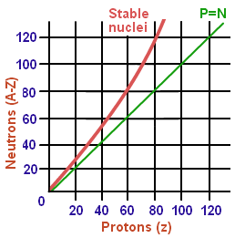
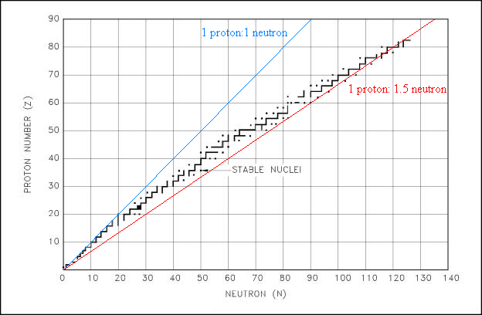
Stability in the nucleus
The Strong Nuclear Force is mostly responsible for holding the nucleus together, but also the distribution of neutrons within the nucleus.

Slide 116
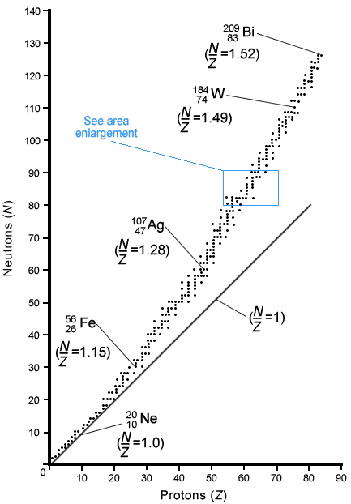
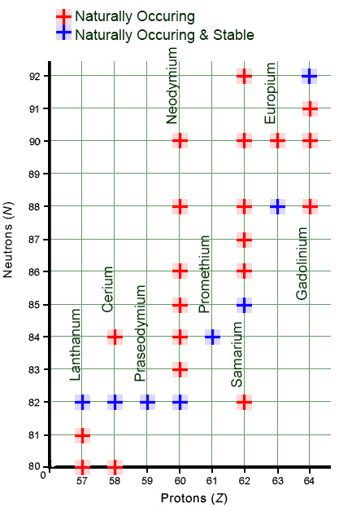
Stability in the nucleus

Slide 117
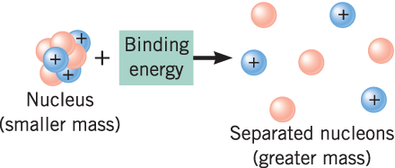
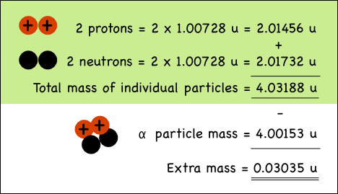
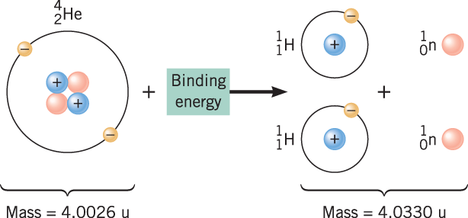
Binding Energy
E = m c²

Slide 118
Electron Volts
1 eV = 1.6 × 10⁻¹⁹ J of energy
Electron volt is used, as Joules seems inappropriate due to the energy being so small.
Example 4.1a:
Thorium-90 emits alpha particles with a maximum energy of 4.05 MeV. Calculate the energy of the alpha particle in Joules.
Solution
4.05 MeV = 4.05 × 10⁶ eV
= 4.05 × 10⁶ × 1.6 × 10⁻¹⁹
= 6.48 × 10⁻¹³ J

Slide 119
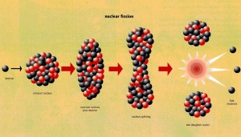
Nuclear Fission
Nuclear fission occurs when an atomic nucleus splits into 2 or more particles.
Fissiles are nuclides capable of undergoing nuclear fission after absorbing a neutron.
Nuclear fission (aka Ferni's reaction) is where a neutron bombards an atom resulting in the splitting of that atom.

Slide 120
Nuclear Fission
Example:
¹₀ n + ²₉³₂⁵ U → ²₉³₂⁶_{m} U → ⁹₃¹₆ Kr + ¹₅⁴₆² Ba + 3 ¹₀ n + energy
Occasionally the reaction produces ¹₀ n + ²₉³₂⁵ U → ²₉³₂⁶_{m} U → ⁹₃⁰₇ Rb + ¹₅⁴₅³ Cs + 3 ¹₀ n + energy
The energy from fission is Kinetic Energy
m - metastable atom that oscillates with great force until a reaction occurs.
energy is also released and in nuclear reactors it is the energy that is collected.

Slide 121
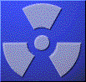
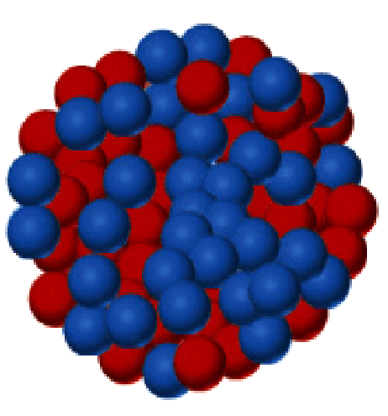
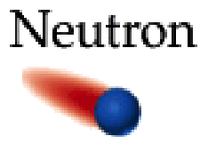
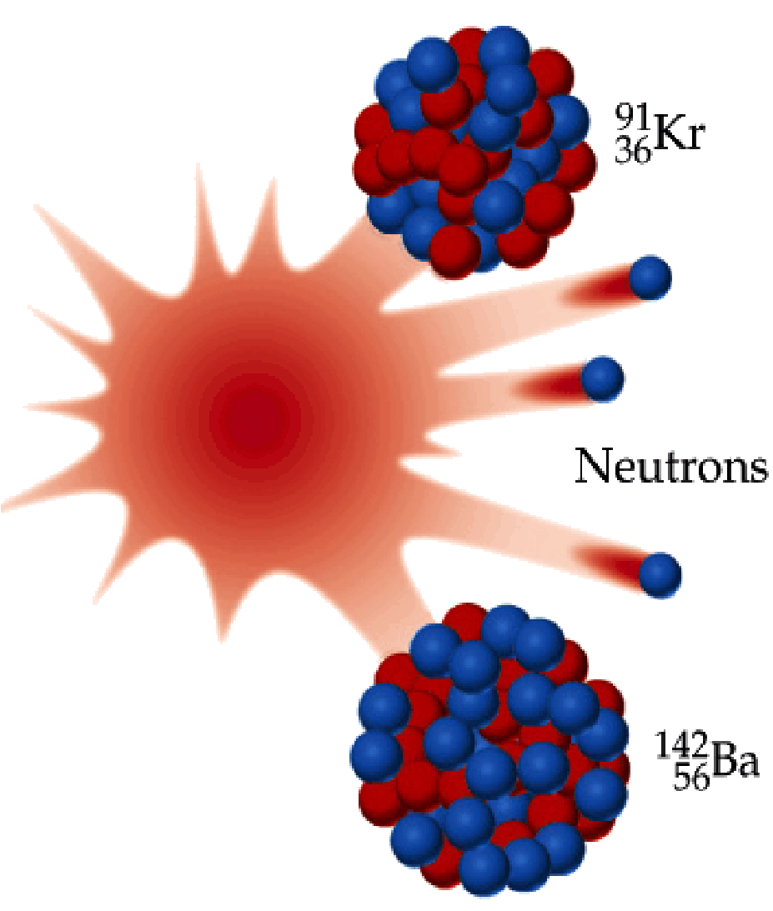
Nuclear Fission is the fragmentation of heavy nuclei to form lighter, more stable ones.
The Fission of U - 235
This is only one of several fissures that are possible.
On average 2.5 neutrons are released

Slide 122
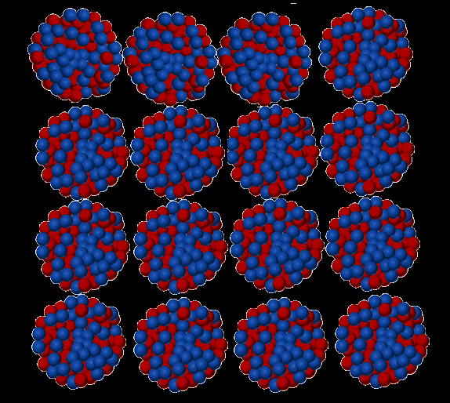
Nuclear Fission
Critical mass is the mass required for the chain reaction to become self-sustaining.
Some neutrons may :
All lost
Cause more fission
One lost
neutron
Be absorbed by an atom causing no further reaction
For a chain reaction to be self sustaining, every fission must produce at least one more neutron that will initiate further fissions.

Slide 123
Binding Energy and Mass Defect
Binding energy is the "energy equivalent" of the mass that is "missing" after the proton and neutrons are blinded to form an atom.
Generally, the mass of an atom is less than the mass of the nucleons that make up the atom. The difference or "mass defect" is the binding energy.
The greater the binding energy, then the greater the stability of the atom.
Looking at Einstein's energy equation E = m c²
It is evident that mass and energy are interchangeable entities.
The "actual" mass of a "binded" nucleus is measured using a mass spectrometer.

Slide 124
Binding Energy and Mass Defect
Careful measurements show that the mass of a particular atom is always slightly less than the sum of the masses of the individual protons, neutrons and electrons of which the atom consists.
e.g. a helium nucleus consists of 2 protons and 2 neutrons
The difference between the mass of the atom and the sum of the masses of its parts is called the mass defect (m_{d}).
2 protons & 2 neutrons
Helium atom

Slide 125
Binding Energy and Mass Defect
Example 4.2a:
a) Compare the sum of the mass of the particles contained within the Uranium-238 atom with its atomic mass of 238.05080 μ. (m_{p} = 1.00728 μ, m_{n} = 1.00867 μ, m_{e} = 0.00055 125 μ)
Solution
Uranium-238 is ²₉³₂⁸ U, hence has 92 protons, 146 neutrons.
Mass of individual particles
m_{T} = 92 × 1.00728 + 146 × 1.00867
= 239.9356 μ
Mass defect (binding energy)
m_{d} = 239.9356 – 238.05080
= 1.88478 μ

Slide 126
Binding Energy and Mass Defect
Example 4.2a continued:
b) Explain these discrepancies.
When the atom is formed some of the mass of the constituent particles are converted to energy (E = mc²) leaving the mass of the atom less than the sum of the masses of its constituents.
c) What is the name given to this discrepancy in mass?
Mass defect

Slide 127
Binding Energy and Mass Defect
Example 4.2a continued:
d) Calculate the binding energy per nucleon in Joules and electron volts (NOTE: 1 μ = 1.6606 × 10⁻²⁷ kg)
Mass defect, m_{d} = 1.93538 μ
STEP 1: Find the mass in kg
1 μ = 1.6606 × 10⁻²⁷ kg
Hence 1.93538 μ = 1.93538 × 1.6606 × 10⁻²⁷ kg = 3.21382 × 10⁻²⁷ kg
STEP 2: Find the energy in Joules
E = mc², where c = 3 × 10⁸ m s⁻¹
= (3.21382 × 10⁻²⁷) × (3 × 10⁸)² = 2.892 × 10⁻¹⁰ J in the nucleus
STEP 3: Find the energy in Joules per nucleon
E_{J} = (2.892 × 10⁻¹⁰) ÷ 238 = 1.215 × 10⁻¹² J
STEP 4: Find the energy in eV per nucleon
E_{eV} = (1.215 × 10⁻¹²) ÷ 1.602 × 10⁻¹⁹ = 7.59 × 10⁶ eV = 7.59 MeV

Slide 128
Binding Energy and Mass Defect
Example 4.2b:
Calculate the energy released from one reaction in the Sun (in Joules and electron Volts) given a standard reaction of;
²₁ H + ³₁ H → ⁴₂ He + ¹₀ n + energy
m_{H-2} = 2.01355 μ, m_{H-3} = 3.01605 μ,
m_{He-4} = 4.0026 μ, m_{n} = 1.68 × 10⁻²⁷ kg
Solution
STEP 1: Find the mass of the neutron in μ
m_{n} = (1.68 × 10⁻²⁷) ÷ (1.6606 × 10⁻²⁷) = 1.01205 μ
STEP 2: Find energy defect
²₁ H + ³₁ H → ⁴₂ He + ¹₀ n + m_{d}
2.01355 + 3.01605 = 4.0026 + 1.00665 + m_{d}
m_{d} = 0.018335 μ

Slide 129
Binding Energy and Mass Defect
Example 4.2b continued:
STEP 3: Convert the mass defect in μ to kg
m_{d} = 0.018335 × 1.6606 × 10⁻²⁷
= 3.04361 × 10⁻²⁹ kg
STEP 4: Convert the mass (kg) into energy (J)
E_{J} = mc²
= 3.04361 × 10⁻²⁹ × (3 × 10⁸)²
= 2.7392 × 10⁻¹² J
STEP 5: Convert to electron Volts (eV)
E_{eV} = (2.7392 × 10⁻¹²) ÷ 1.602 × 10⁻¹⁹
= 1.7099 × 10⁶ eV
= 1.71 MeV

Slide 130
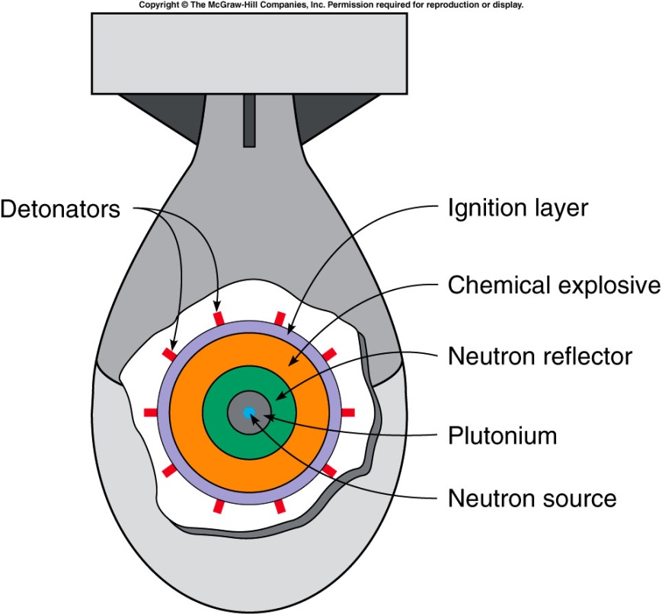
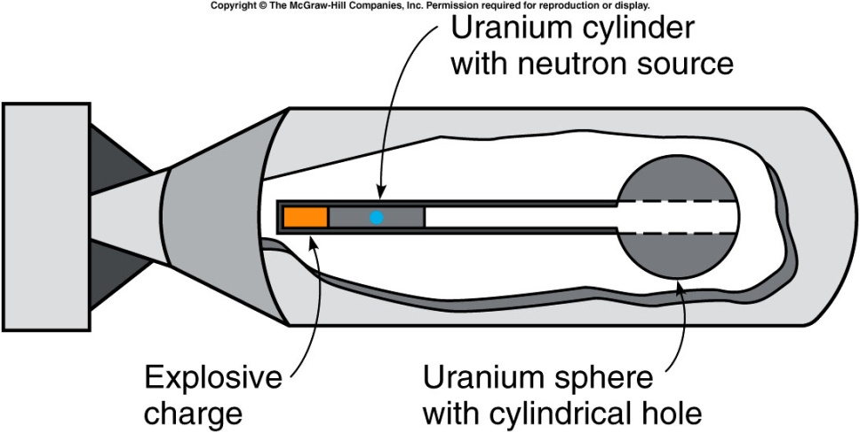
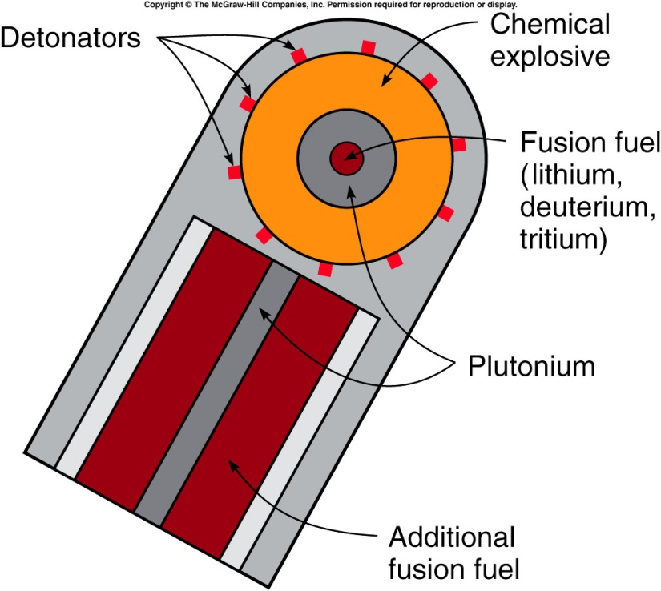
Fission Weapons
Usually low-energy (low Kinetic energy, hence low speed) neutrons are easily absorbed into a U-235 nucleus. It has to be slow enough to allow the strong short-range nuclear force to capture the neutron and drag it into place.
U-238 is not very fissile (quick to decay), however, it’s daughter Pu-239 is highly fissile.

Slide 131
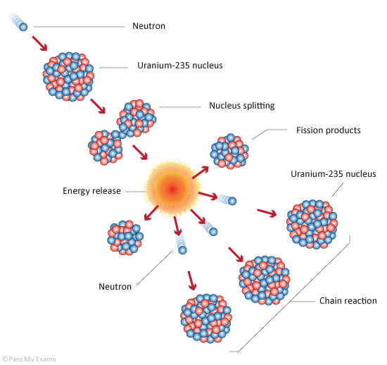
Chain Reaction
Chain reaction is where for every decaying radioactive nuclei,
which results in the release of one or more neutrons,
that at least one neutron is absorbed into another nuclei,
resulting in another radio-nuclei reaction.

Slide 132
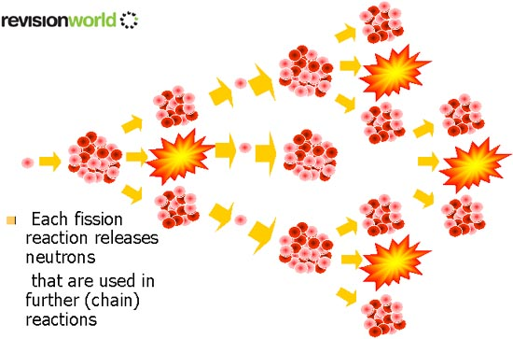
Chain Reaction

Slide 133
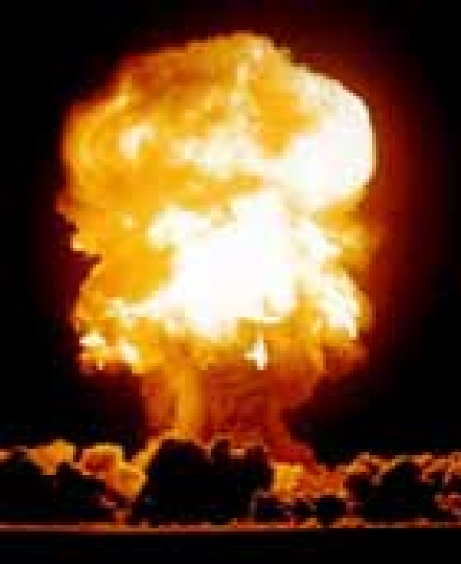

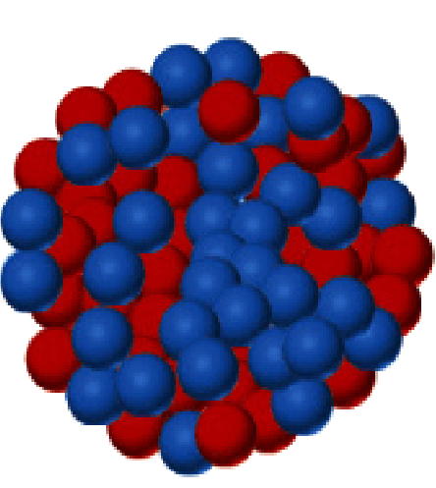
Neutrons released in the fission of ²³⁵U can induce three more fissions, then nine, and so on leading to a chain reaction.

Slide 134
Critical Mass
Is the desired design of material that sustains the level of decay required. This is achieved by;
Shape of material. A spherical shape provides the least surface area. The least surface area means less neutrons escaping and increasing the chance of a chain reaction.
Purity of the material. The greater the purity the more reactions as neutrons are more likely to find their targets.

Slide 135
Homework, Context & Keywords
Context: How is this content used to better society?
Key words:
Formation of new energy sources and alternatives to existing nuclear energy sources.
Electron Volts
Fission
Chain Reaction
Critical Mass
Binding Energy
Mass Defect

Slide 136
Homework, Context & Keywords
Homework:
Complete all questions from
Nelson Set 4.1 & Set 4.2
Chapter 4.1 & 4.2 Extra Questions
Chapter 4.1 & 4.2 Exam Questions
due first lesson next week.
Read Chapter 4.3 & 4.4 page 117-131 and answer Q1&2 from Set 4.3 and
Q1,2&3 from Set 4.4
by next lesson.

Slide 137
Page Setup
Set up the first page of every lesson like this and rule a column line for every page after the first page that is used during the lesson.
Focus: State the Chapter Number, Title and the page numbers (3 lines).
Keywords: During the lesson write out your own keywords used during the lesson. (8 lines)
Context: During the lesson write in this section what this topic relates to in the ‘real’ world. How is this content used to better society? (5 lines)

Slide 138
Nuclear Reactors and Fusion
Chapter 4.3 & 4.4
Pages 117-127 & 128-131

Slide 139
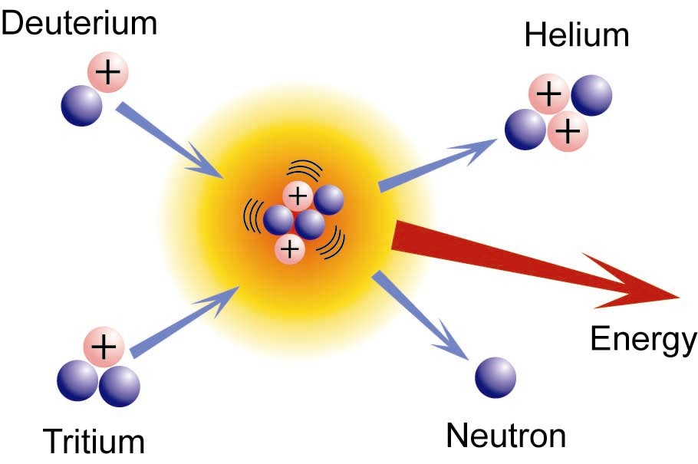
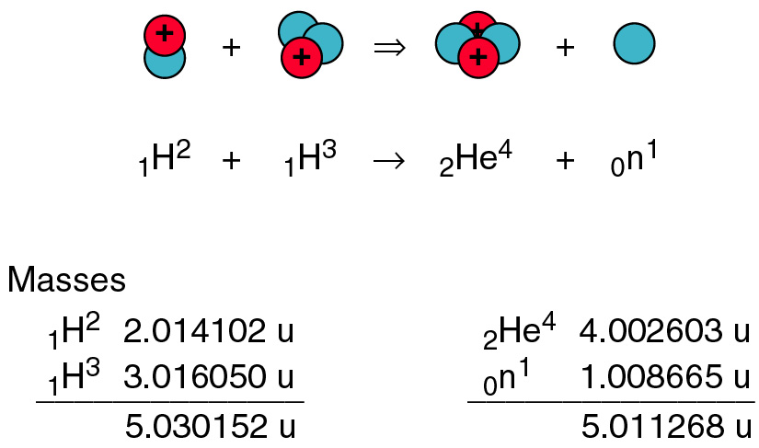
Fusion
When two or more atoms are forced together to produce a new larger nucleus.
Example: The reaction in the Sun
²₁ H + ³₁ H → ⁴₂ He + ¹₀ n + 1.71 MeV (released)

Slide 140
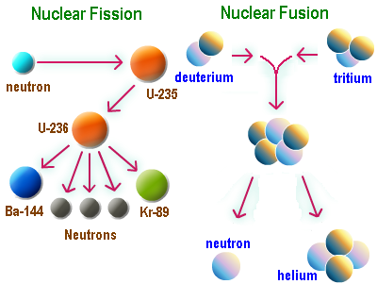

Slide 141
Nuclear Reactor
Boron control rods absorb neutrons to control the reaction
Pressure vessel and biological shield
To heat exchanger where steam is produced
Fuel Rods remain in reactor until spent
Graphite Moderator slows neutrons to thermal energies [1 MeV]
Coolant [CO₂ or H₂O] to extract energy

Slide 142
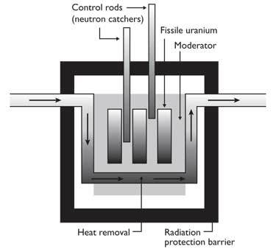
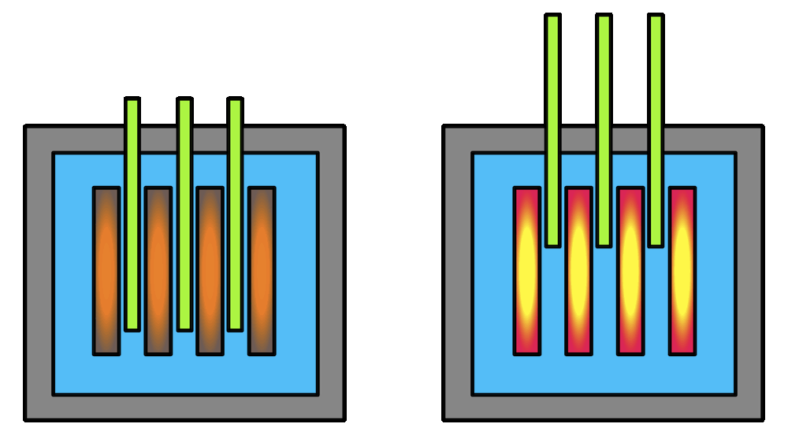
Basics of Reactor Fuel Rods
Fuel (uranium) atoms react with neutrons expelled from nucleus of previously reacting fuel (uranium) atoms.
The control rods absorb some of these stray neutrons.
The amount of control rods present dictates the number of neutrons free to react with the fuel (uranium) rods and the number of neutrons absorbed by the control rods.

Slide 143


Basics of Reactor Fuel Rods
A diagram of a modern pressurized-water nuclear reactor. Hot water coming from the reactor is converted to steam when the pressure is reduced in the steam generators. The steam turns the turbines, which power the electric generator.

Slide 144
Homework, Context & Keywords
Context: How is this content used to better society?
Key words:
How reactors can replace coal based power stations efficiently.
Fusion
Biological Shield
Moderator
Control Rod
Coolant
Heat Exchanger

Slide 145
Homework, Context & Keywords
Homework:
Complete all questions from
Nelson Set 4.3 & Set 4.4
Chapter 4.3 & 4.4 Extra Questions
Chapter 4.3 & 4.4 Exam Questions
due first lesson next week.
Read Chapter 5.1 page 140-146 and answer Q1&2 Set 5.1
by next lesson.
Chapter 4 Review questions page 137 – 138 due first lesson next week.

